Slide 1

Ben Carpenter
Tri-Tech Skills Center Cybersecurity Program

Slide 2

About Erm… Me Obviously 🤓
Passionate about technology & Linux
Daily driving Linux
Love Resident Evil
Love GNOME desktop

Slide 3
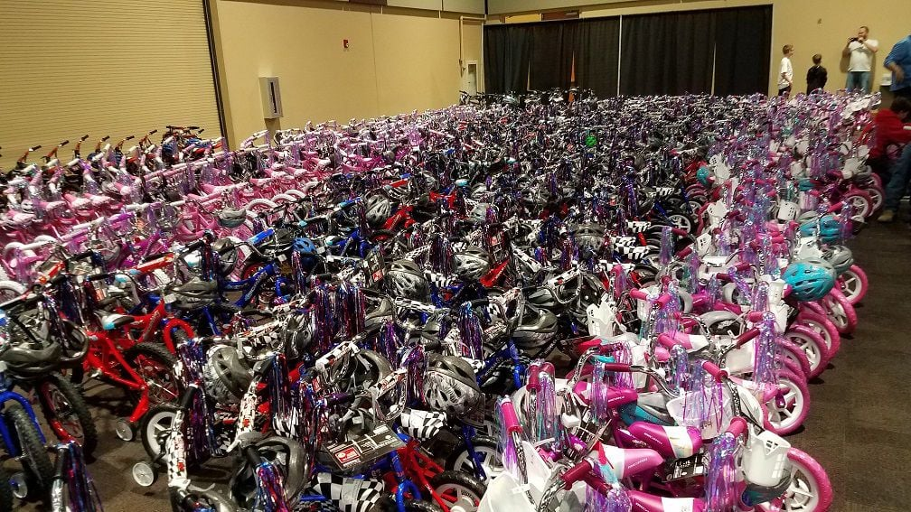
Portfolio
Bikes for tikes

Slide 4
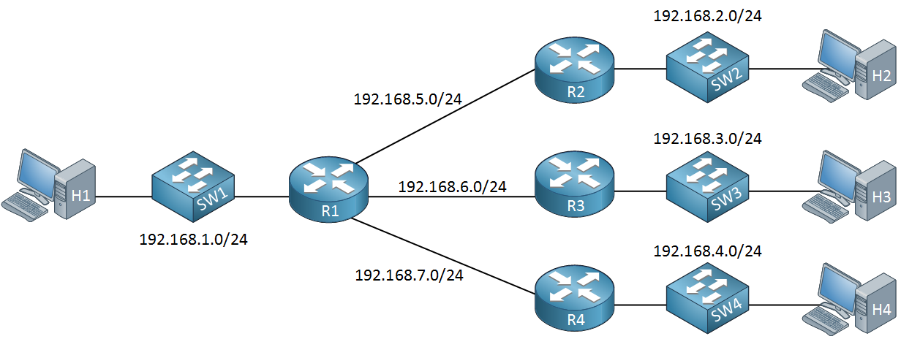
Reflection of Learning
Python
Subnetting
Wireshark

Slide 5
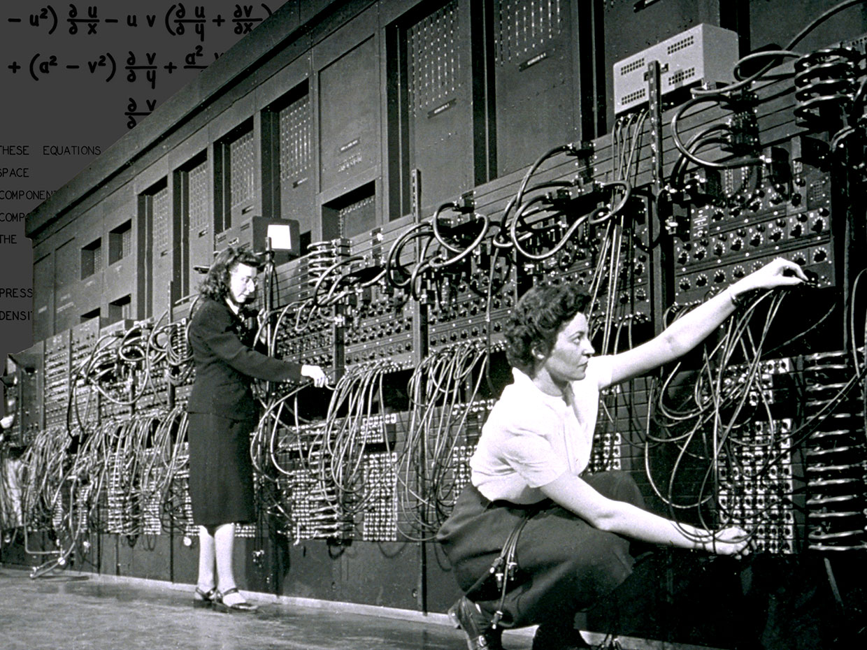
Successes
Computer build project
Everything.

Slide 6

Challenges
Subnetting
Getting things done
Not much

Slide 7
Advantages & Disadvantages
Tri-Tech Advantages:
Days feel shorter
The people
No Microsoft Windows
Tri-Tech Disadvantages:
Not well suited for a disorganized person
Stressful at times (me problem)
Not a lot of creative freedom

Slide 8

Beyond High School
Computer Science or Physics degree
CBC

Slide 9
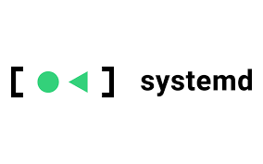
Employability
Leadership – computer build
Teamwork – computer build
Expanded on what I already knew, Linux, Systemd, Programming (C, Python)

Slide 10
Acknowledgments
Mi Mama

Slide 11
Sources
Resident Evil picture - https://assets1.ignimgs.com/2019/01/22/residentevil2-blogroll-1548123721286_160w.jpg?width=1280
Bikes for Tikes picture - https://bloximages.newyork1.vip.townnews.com/nbcrightnow.com/content/tncms/assets/v3/editorial/b/58/b58e0e64-188b-11ea-8582-87c3da94612a/5deaf79fba117.image.jpg
Subnetting picture - https://networklessons.com/wp-content/uploads/2017/01/network-subnetting-example-class-c.png
First computer programmers picture - https://assets.rbl.ms/25588099/origin.jpg
Distracted picture - https://images.squarespace-cdn.com/content/v1/5189abd0e4b0d70f7844ac89/1613171154852-J550G4RIHU5BKOM8QDAA/1Anxiety+copy.png
CBC picture - https://encrypted-tbn0.gstatic.com/images?q=tbn:ANd9GcQydnfD5fTQs-ZIkmsvm6yc2PcnhUsoTLJjErI0DtS0qwDeq15fSioCpu3AlXqers7KytY8cvSzOSM:https://cbchawks.com/images/logos/site/site.png&usqp=CAU&ec=48665701

Slide 12
Questions?

